Slide 1


Slide 2


Introduction To Computers

Slide 3
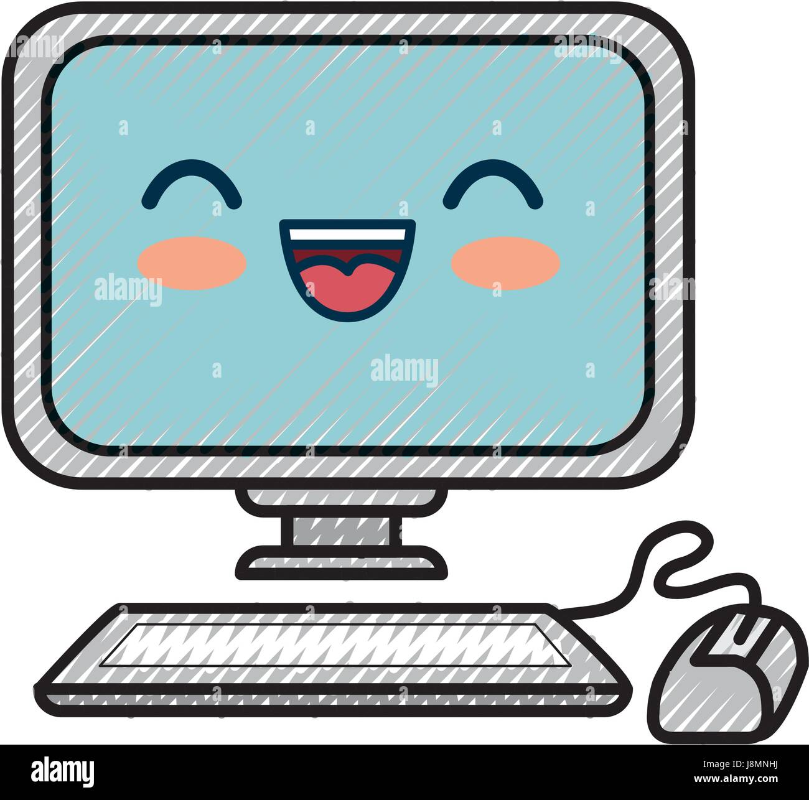

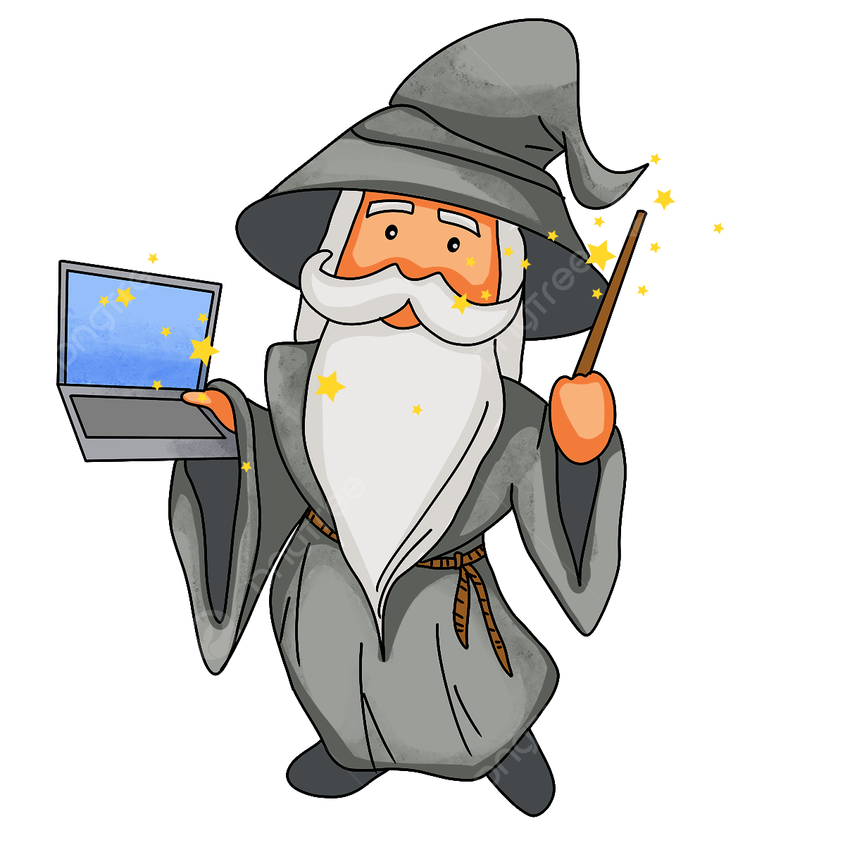
COMPUTER
"A computer is an electronic device that helps us give input (like typing or clicking) and get output (like seeing pictures or hearing sounds). It's like a magic box that does what we tell it to do!"

Slide 4
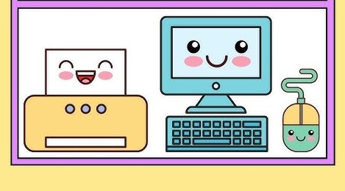
PARTS OF COMPUTER

Slide 5

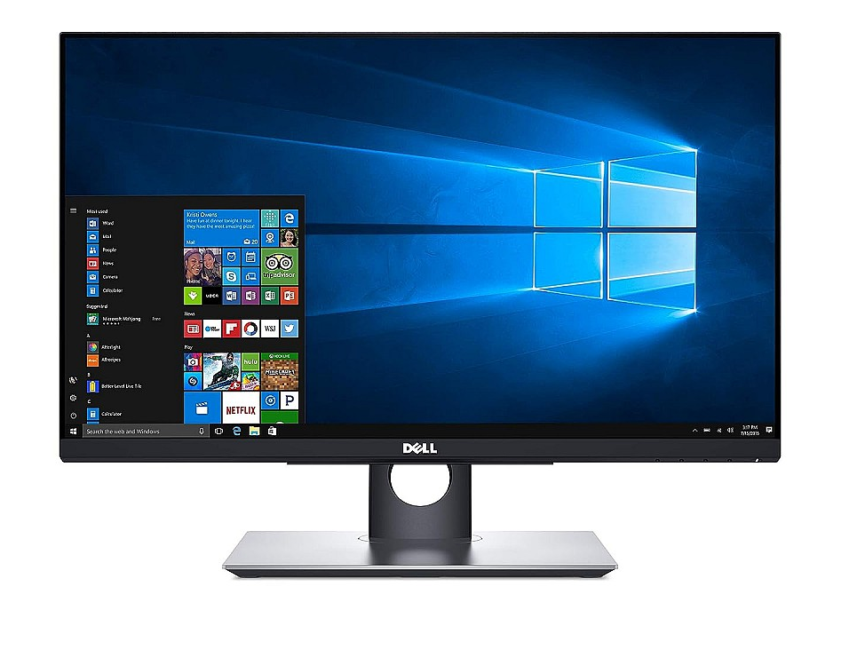
MONITOR

Slide 6
A monitor is the part of the computer that shows us pictures, videos, and words. It’s like a TV screen where we can see everything happening on the computer.

Slide 7
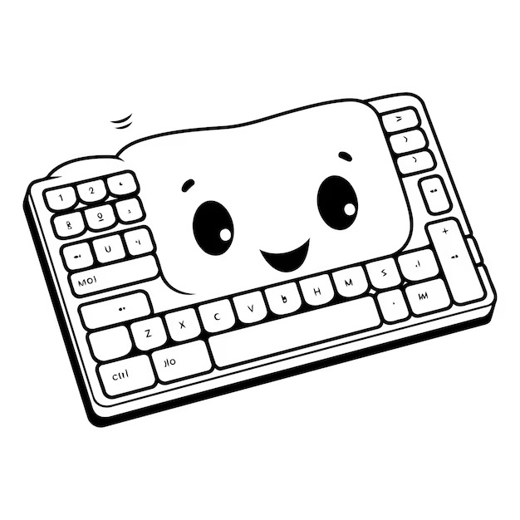
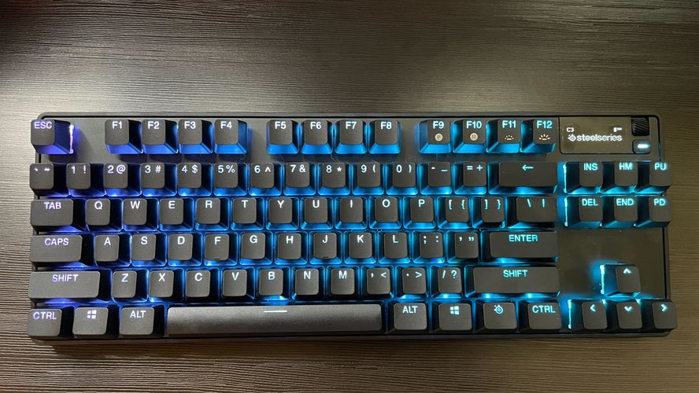
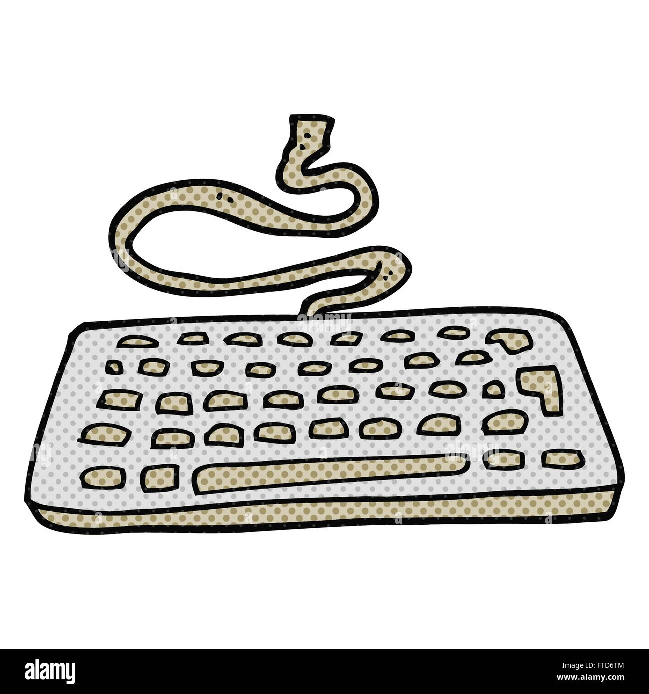
KEYBOARD
104 Keys

Slide 8
A keyboard is a part of the computer that has buttons (called keys) we press to type letters, numbers, and special symbols. It's like a set of buttons that helps us communicate with the computer.

Slide 9
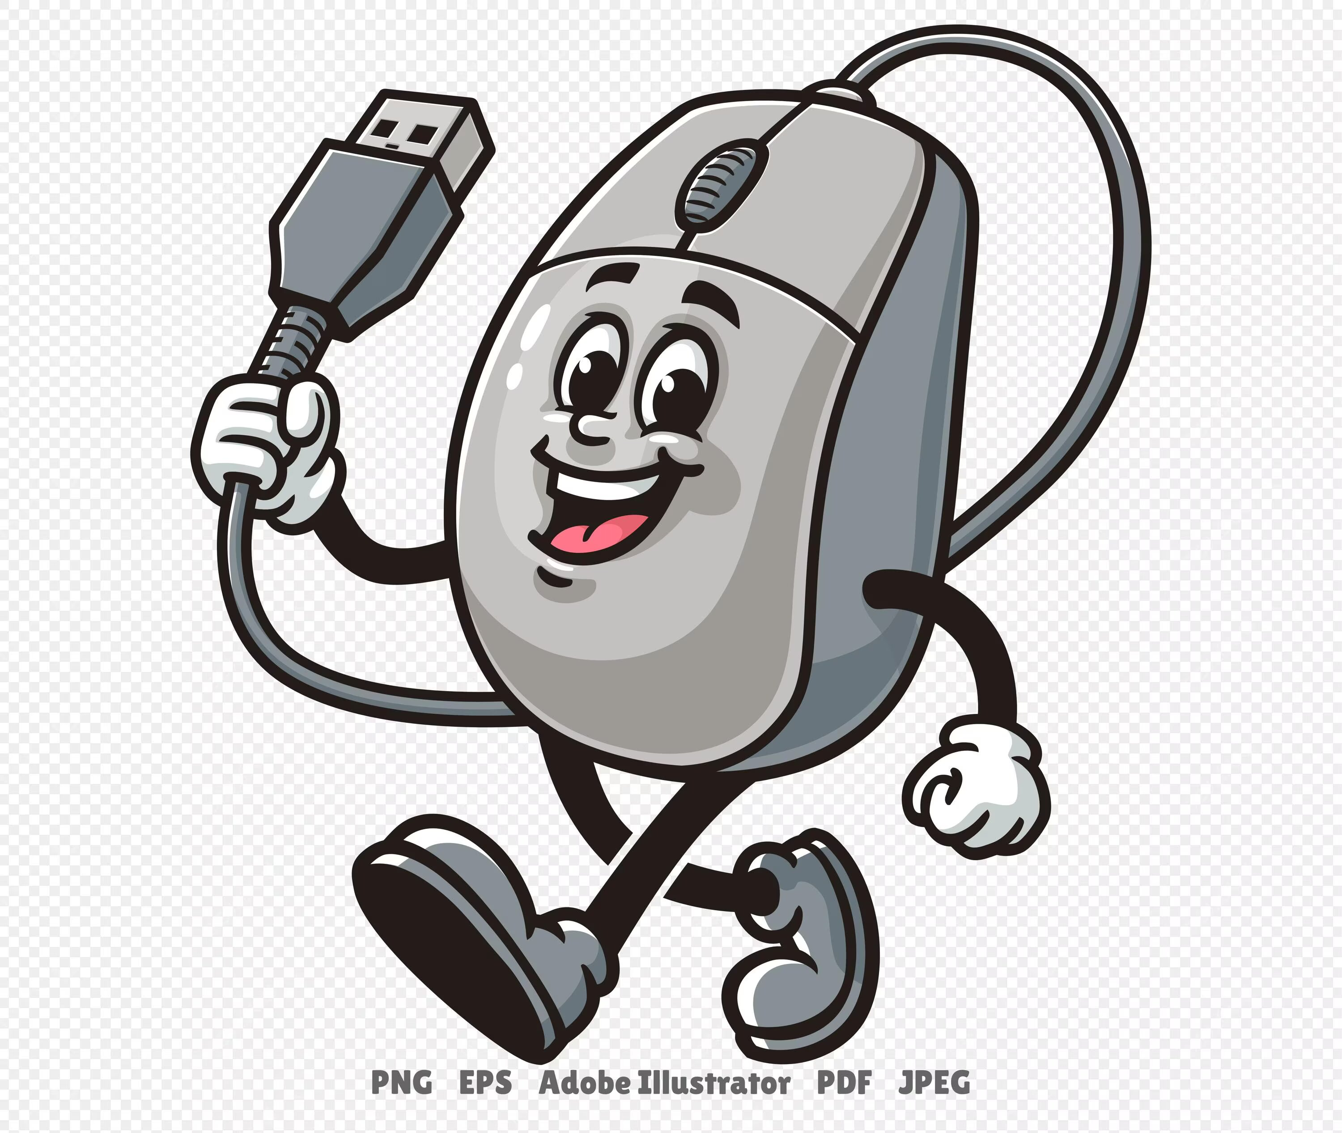
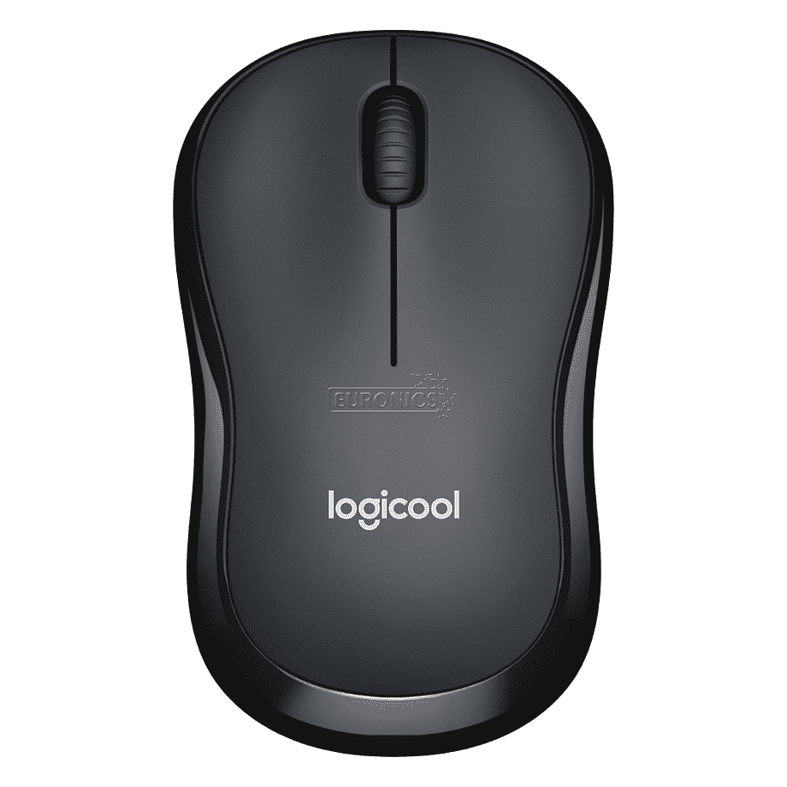
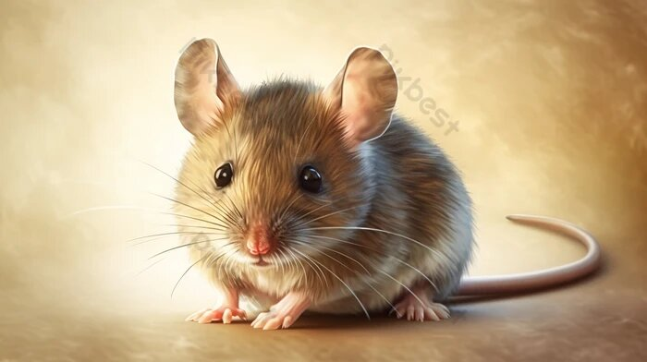
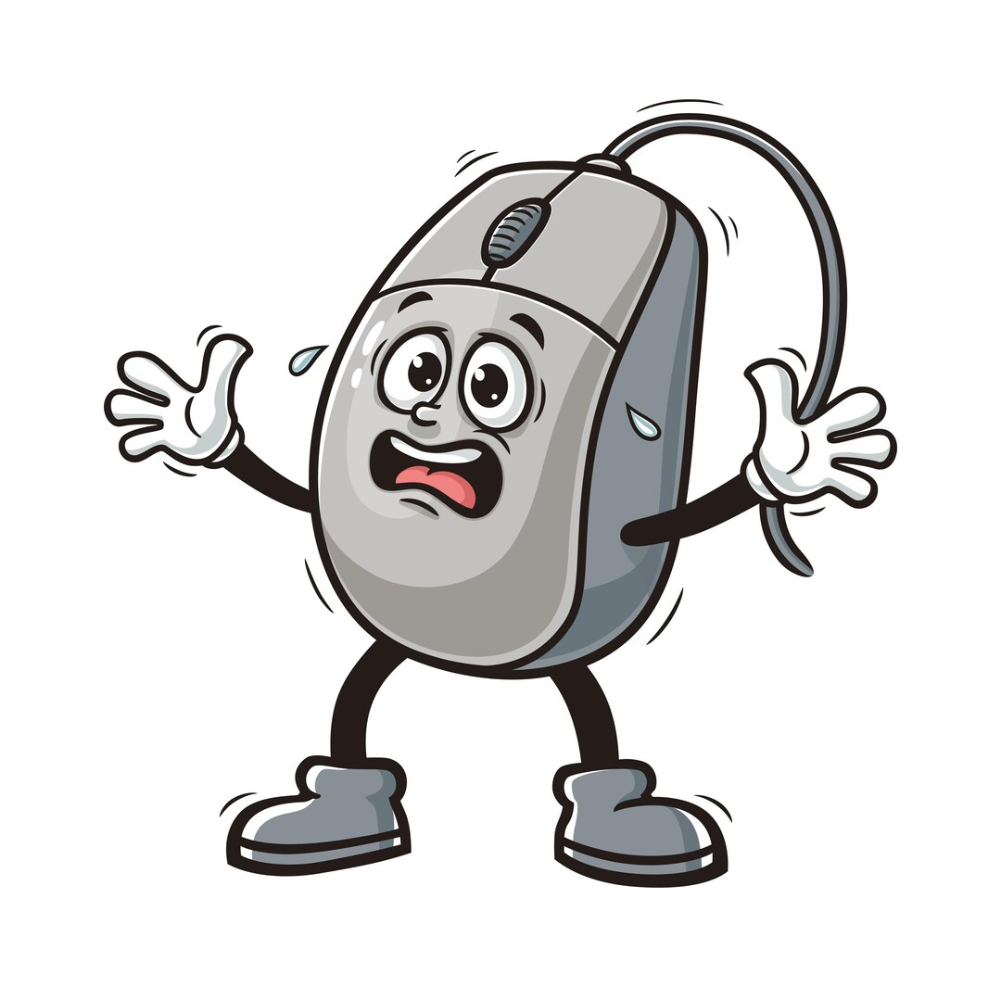
MOUSE

Slide 10

A mouse is a small device we move with our hand to point and click on things on the screen,
like opening files or playing games.

Slide 11

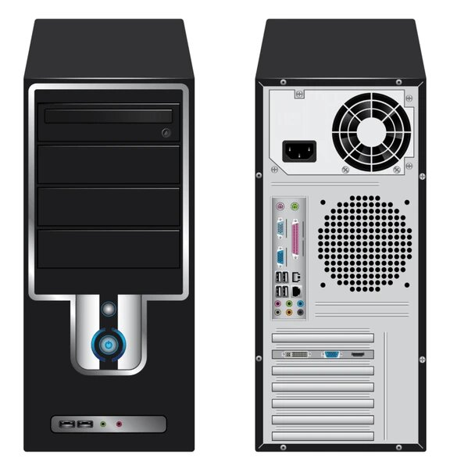
CPU
Central Processing Unit

Slide 12
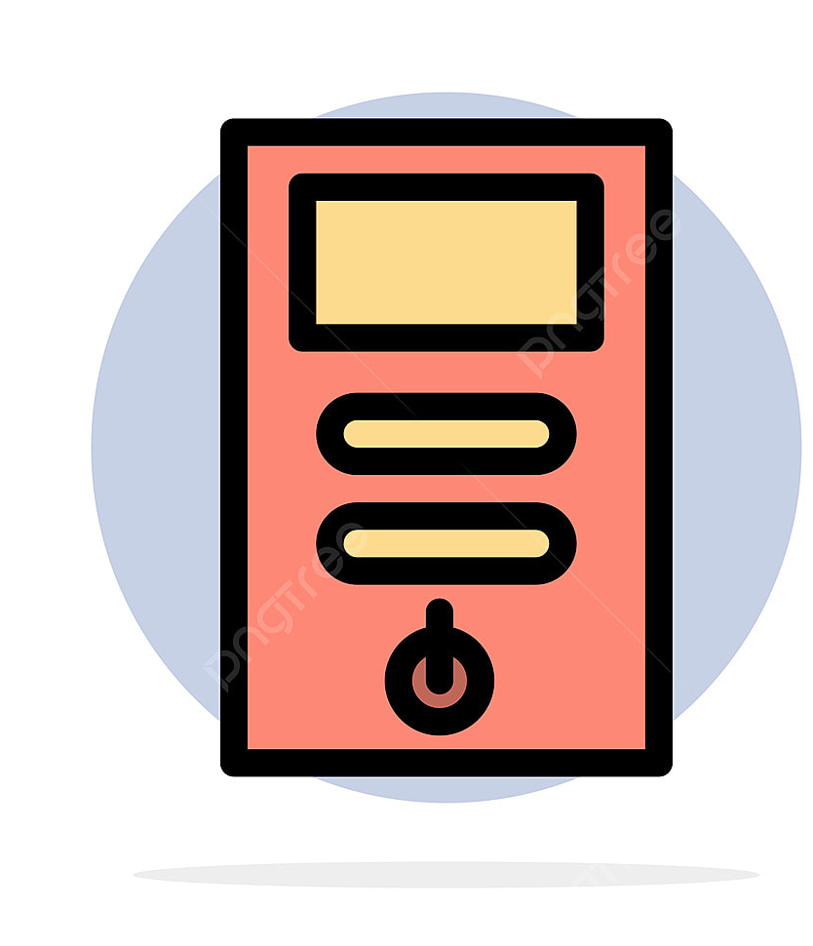
The CPU is the brain of the computer. It follows the instructions we give it, like when we click the mouse or type on the keyboard, to make the computer work.

Slide 13
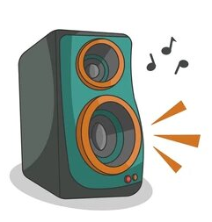
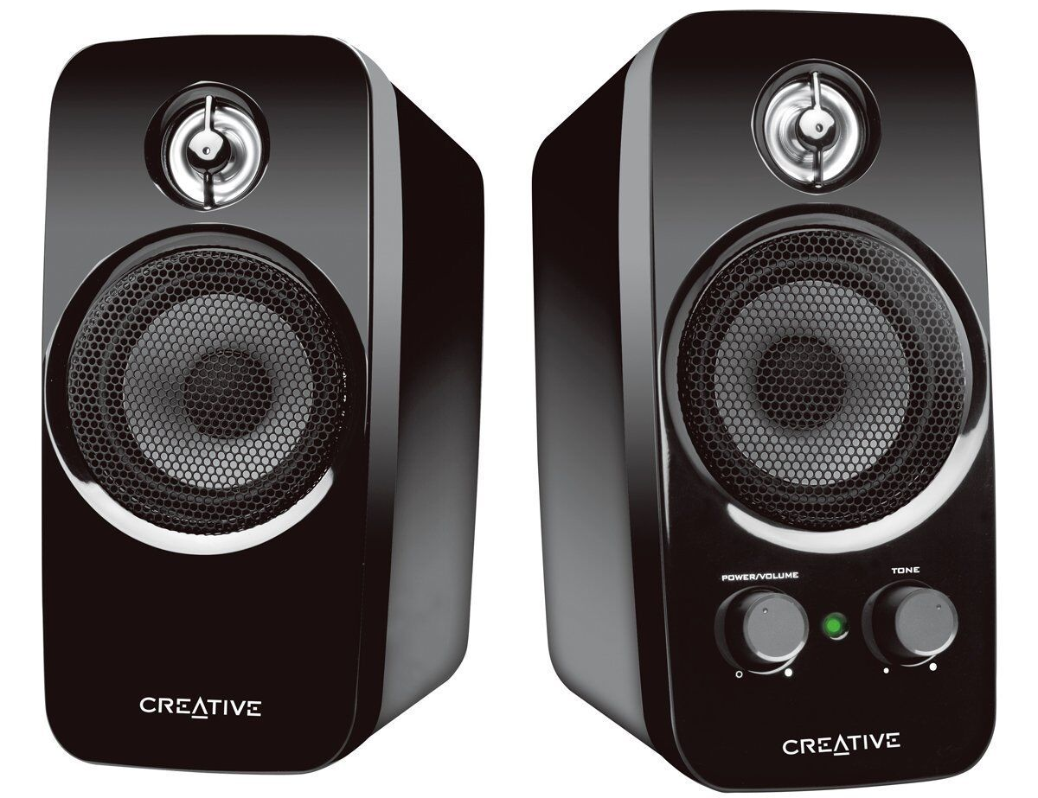
SPEAKERS

Slide 14
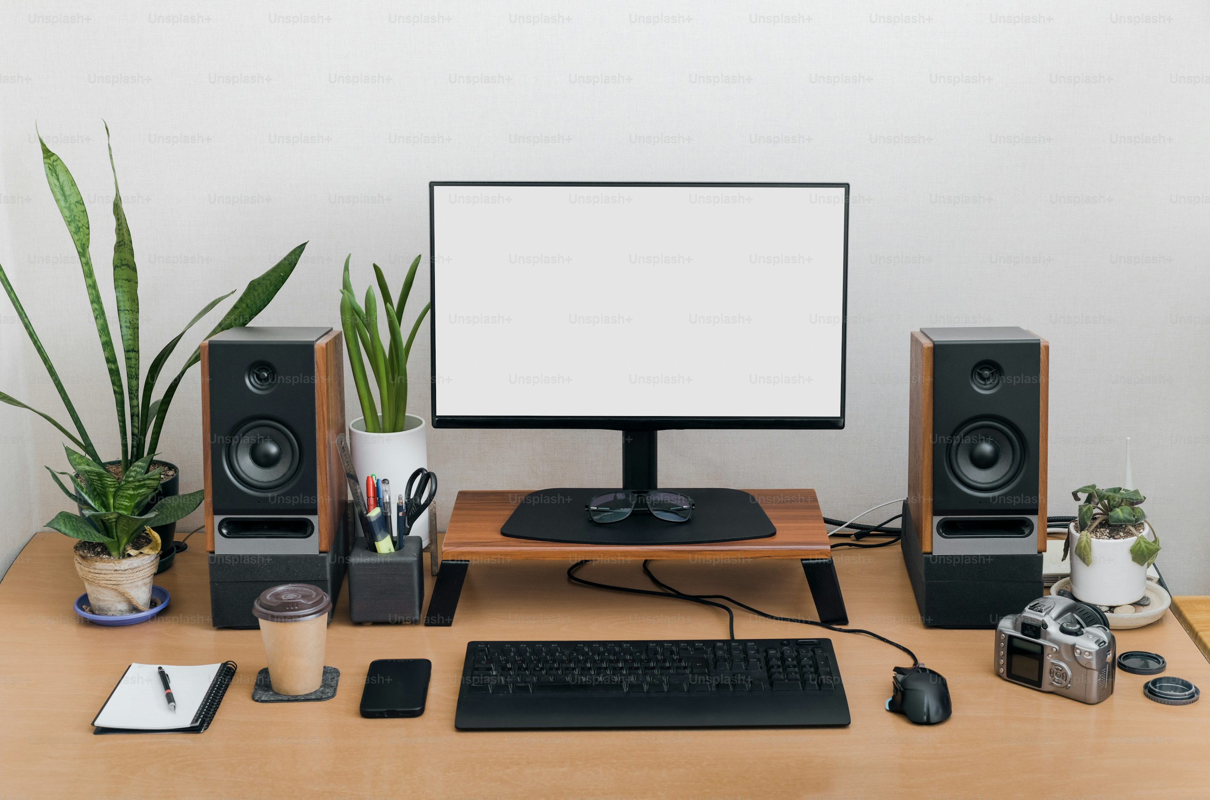

Slide 15
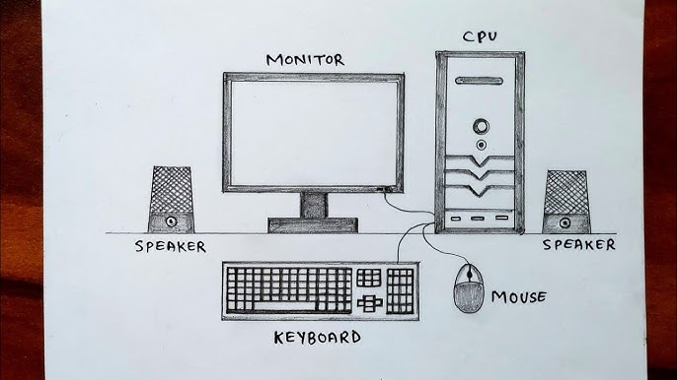
Let’s Draw

Slide 16
